Slide 1

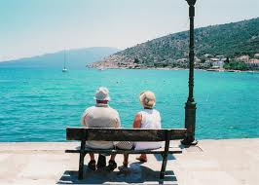
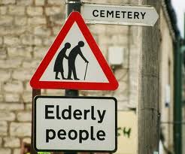
SC 1101E
Lecture 10
Ageing and Society

Slide 2
Final Exam
Covers all 11 topics
2 sections
Each section has 3 questions
Answer 1 question from each section
Total of 2 questions
2-hour
2 to 3 pages
Notes:
Expected length per essay is 2 or 3 pages

Slide 3
Considering the social changes occurring in the contemporary world, do you think it is possible and necessary to define “family”?
1. Social changes (brought about by industrialization, modernization, urbanization, globalization, post-modernization) produce a diversity of family forms.
2. Earlier sociological/ anthropological literature focused on a narrower range of family forms, but common characteristics (structure, roles, relations, and functions) can be discerned.
3. Contemporary world sees the emergence of new family forms (examples?) which do not fit in so nicely with earlier definitions.
4. Necessary to define “family”? Family is an important social institution, sociologically and policy-wise.
5. Possible to define “family”? Yes, it is about primary, intimate, supportive relations. Not necessarily the one you are born into, but the one you choose.
Notes:
Earlier literature do not cover all the ranges of family forms.

Slide 4
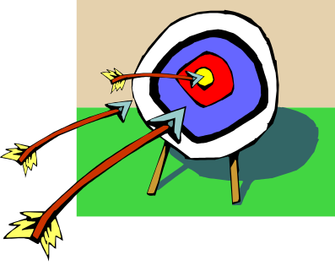
Outline
Situation Report: what and why of greying population.
Defining old age
Challenges
Social arrangements
Social support and social policy
Theories
The Future
Notes:
No education: when they are old they have to do odd jobs. Poor: lack of opportunities or lack of motivation to work hard?

Slide 5
Situation Report (1): what’s happening in Singapore?
 | 1970 | 1980 | 1990 | 2000 | 2010 | 2013 (Citizens2014) | 2030 projected
Median Age | 19.5 | 24.4 | 29.8 | 34.0 | 37.4 | 38.9 (40.4) | 41.2
Proportion 65+ (%) | 3.4 | 4.9 | 6.0 | 7.2 | 9.0 | 10.5 (12.4) | 18.9
Old Age Support Ratio (number of aged 15-64 per elderly) | 17.0 | 13.8 | 11.8 | 9.9 | 8.2 | 7.0 (5.2) | 3.4
Sources: Social Statistics in Brief 2014; Population in Brief 2014.
Notes:
Ageing is associated with downward mobility. But poverty among the old could be an entrenched problem relating to disadvantaged education and employment situation. Raising the retirement age provoked two contrasting responses. In Singapore, unionists cheered while in France they protests.

Slide 6
Situation Report (2):
Comparisons with other countries
Country | %60+ 2005 | %60+ 2050 | Median Age, 2005 | Median Age, 2050 | %80+ 2005 | %80+ 2050
US | 16.6 | 26.8 | -- | -- | 3.5 | 7.6
Japan | 26.4 | 44.0 | 42.9 | 54.9 | 4.8 | 15.5
Korea | 13.7 | 42.2 | 35.0 | 54.9 | 1.4 | 12.7
China | 11.0 | 31.1 | 32.5 | 45.0 | 1.2 | 7.3
India | 7.5 | 20.2 | 23.8 | 38.6 | 0.7 | 3.1
Singapore | 12.3 | 39.8 | 37.5 | 53.7 | 1.5 | 14.8
Source: Timonen, 2008.

Slide 7
Population Ageing: Causes
 | 1970 | 1980 | 1990 | 2000 | 2008 | 2013
Single aged 35-39 Male (%) | 10.8 | 10.5 | 18.1 | 19.7 | 19.4 | 19.9
Female (%) | 5.1 | 8.5 | 14.8 | 15.1 | 15.2 | 17.3
Total Fertility Rate (per female) | 3.07 | 1.82 | 1.83 | 1.60 | 1.28 | 1.19
Crude Death Rate (per ‘000 population) | 5.2 | 4.9 | 4.7 | 4.5 | 4.4 | 4.5
Life Expectancy at birth (years) | 65.8 | 72.1 | 75.3 | 78.0 | 80.9 | 82.5
Male | 64.1 | 69.8 | 73.1 | 76.0 | 78.4 | 80.2
Female | 67.8 | 74.7 | 77.6 | 80.0 | 83.2 | 84.6
Source: Population in Brief 2014

Slide 8
Demographic Transition
Stage 1: High fertility, High mortality rates.
Stage 2: Declining mortality rates. Fertility rates remain high. High population growth rates.
Stage 3: Declining fertility rates. Population growth rates slow down.
Stage 4: Low fertility and mortality rates.

Slide 9
Why study population ageing?
1. Ageing is pervasive (affects everyone). Implications for intra- and inter-generational equity, cf. sandwiched generation.
2. Ageing has significant consequences for the economy.
3. Ageing is an unprecedented phenomenon. Its effect on society is likely to be enduring and irreversible.

Slide 10
Defining old age
Chronological age = number of years.
Biological age = functioning of the body and its component parts.
Psychological age = memory, intelligence, feelings, motivation.
Sociocultural age = socially assigned roles and expectations.
Subjective age identity, e.g. “young at heart”.

Slide 11
Ageing and life-course
Elder (1978): Life-course = pathways by which individuals move throughout their lives, fulfilling different roles sequentially or simultaneously.
Cockerham (1997):
middle age (40-55); later maturity (55-75); old age (75 & over)
Laslett (1996):
The 3rd Age (50-74), 4th Age (75 & Over)
Singapore:
Young-Old (65-74), Old (75-84), Oldest-Old (85 & over)
Notes:
From the time u are born and the time you die, u go through different pathways. In Singapore, old age is 75 and above.

Slide 12
Challenges of old age (1)
Retirement: loss of status and income
Widowhood (cf. gender differences)
Contraction of social networks: social isolation
Loss of health: mental, physical. Elder suicides.
 | Male | Female
75-79 | 29,700 | 38,000
80-84 | 17,500 | 26,600
85 & Over | 11,100 | 22,500
Source: Population Trends 2012
Notes:
High chance of widowhood as the husband usually dies early. Women can connect with the society better after retirement than old man.

Slide 13
Challenges of old age (2)
Age stratification:
1. simple society: old age is a liability.
2. agrarian society: gerontocracy. Elders possess most wealth, power, and prestige.
3. (post) industrial society: Elders (positive connotation) became “elderly” (negative connotation).
Notes:
Simple society: Hunting society
Agricultural society: Agrarian.
Our type of society: negativity.

Slide 14

Challenges of old age (3)
Retirement planning
1. Financial
2. Employment
low education, but improving
3. Social
4. Health
Formal support: CPF system, CPF Life, MediShield Life
Informal support: living arrangements, intergenerational transfers.
Are the above adequate? Rising old age dependency ratio. Do families have the capacity to take care of their own? Sandwiched generation.
Notes:
CPF has high interest rates. Low education but do not save a lot. Social: need to be connected with the family.

Slide 15
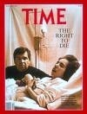
Challenges of old age (4)
Death and dying: quantity of life, without quality.
Care-givers: tend to be females. Elder abuse. (Maintenance of Parents Act)
Living wills: end of life care, AMDs.
Euthanasia.
Notes:
Support of parents is necessary. AMD: Advance medical directive.

Slide 16



Social Arrangements (1)
Age differentiated & age-integrated structures (Riley and Riley, 1994):
Old | Leisure | Education | Work | Leisure
Middle | Work
Young | Education
Notes:
Doing all three at different ages of your life, do not need to do one at a time.

Slide 17
Social Arrangements (2)
Retirement:
Mandatory retirement age: 55 to 62, 65, 67
Reduction in salary, and job scope
Can seniors afford to retire?
Do seniors want to retire?
Ageism = Negative stereotypes of elderly people, which prejudicially describe them as senile, rigid in their attitudes and psychologically and socially dependent.
Affects employment and income.
“New Ageism” = Intergenerational conflicts where elderly are condemned as “takers, not “givers”.
Media = reinforces stereotypes?
Notes:
We think of elderly as dependent and not able to contribute and be productive.

Slide 18
Theories (1)
Modernization: decline in the status of elderly people.
Disengagement: Focused on needs of society. To ensure continuous smooth functioning of society. But do elderly people want to disengage?
Activity: Focused on needs of elderly. Disengagement is not inevitable. Elderly people desire to be active. Successful/ active ageing.
Continuity: Elderly people respond in a fashion that is consistent with past adult personality.

Slide 19
Theories (2)
Age-based conflict and stratification/ critical gerontology: Age-based, unequal access to resources, but this is not inevitable.
Feminist: age stratification is compounded by gender inequalities, increasing women’s vulnerability to poverty.
Notes:
Because women tend to live longer.

Slide 20
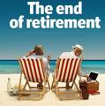
Future: Need to rethink (1)
Financial and support services
Retirement, No?
Familial roles and expectations, including older caregivers.
Social isolation
Political issues: the “grey vote”.
Community life: retirement colonies.
Cultural representations of the elderly: ageing is a varied experience.
Notes:
People dying alone at home unnoticed. Media should reflect positivity in the elderly.

Slide 21
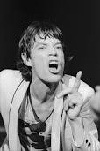
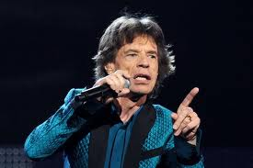
Future: Need to rethink (2)
Marginalization of elderly: Youthful fashion and consumerism.
Medicalization: leading to intervention and control
Body is seen as machine, subject to wear and tear.
Death and dying: death becomes less of a taboo subject.

Slide 22

Parting Shots
Elderly people seen as:
“sick”, “infantile”, “eccentric”
“unproductive”, “burden”
“deviant”
“minority”
“underclass”
Need not be so?

